Slide 1

Lecture 4
PROJECT MANAGEMENT BASICS
PART II
Prof. Nguyen Van Hung

Slide 2
PROJECT MANAGEMENT BASICS
PART II
Chapter 3
Project Planning; project Scheduling; project Monitoring and Controlling; project Evaluating and Terminating.

Slide 3
I- PROJECT PLANNING
1-Project planning – Definition
Project planning is a discipline for stating how to complete a project within a certain timeframe, usually with defined stages, and with designated resources. One view of project planning divides the activity into:
Setting objectives (these should be measurable)
Identifying deliverables
Planning the schedule
Making supporting plans

Slide 4
I- PROJECT PLANNING
1-Project planning – Definition
Supporting plans may include those related to: human resources, communication methods, and risk management.
Computer hardware and software project planning within an enterprise is often done using a project planning guide that describes the process that the enterprise feels has been successful in the past.
Tools popularly used for the scheduling part of a plan include the Gantt chart and the PERT chart.

Slide 5
I- PROJECT PLANNING
2-Why does a project need plans?
Whether you have a small project or a large scale undertaking, it’s important to know that each project can’t just proceed with multiple people working just as randomly as the work goes on. It’s important to understand that each project needs a plan.
But why so?
-A plan is almost like a map. A document of direction that can lead the project towards the objective it’s supposed to be headed to. The plan also ensures that the momentum is kept up when a plan is executed. Along with that, the plan maintains status and also enlists tasks that will take the project to its successful completion.

Slide 6
I- PROJECT PLANNING
2-Why does a project need plans?
With milestones and proper distribution of roles and responsibilities, with schedules, a plan is a wholesome and very well thought through document that covers a step-by-step proceeding of a sequence of actions to achieve a slated goal. When planning is conducted in a systematical and precise manner, it becomes easier for the execution to take place.

Slide 7
I- PROJECT PLANNING
2-Why does a project need plans?
Without a complete and comprehensive plan, it’s difficult to get the execution as smooth as you would require it to be. Thus, this will cost you extra efforts and will delay and utilize more resources than you expect. In order for you to implement a plan, it’s essential to know what a plan can do for you.
Listed below are 4 points that will throw light onto the benefits of planning and having a comprehensive plan at hand:

Slide 8
I- PROJECT PLANNING
2-Why does a project need plans?
2.1 Improving Client Communication and Response
Normally designated as the communication plan, a plan can keep you in constant touch with your clients and improve and maintain relations with them. This way you can be assured that the dealings take place methodically and in the best way possible. With better communication comes the opportunity to understand client needs and wishes correctly. This will enhance the plans put forth and the execution would be close to flawless.

Slide 9
I- PROJECT PLANNING
2-Why does a project need plans?
2.2 Increasing the Transparency of Our Own Work
With a plan in place, you can know what needs to be done and the sequence of steps leading to completion of a particular task. This way even your client will know how the process is taking place and can form a clear picture in their mind of what the team members are doing.

Slide 10
I- PROJECT PLANNING
2-Why does a project need plans?
2.3 Becoming More Organized and Efficient
A clear plan is like a to-do list for you to follow and stay organized. This will double your productivity and will give you the desired results. An organized project is surely a successful project.

Slide 11
I- PROJECT PLANNING
2-Why does a project need plans?
2.4 Focus Lies on the Project Objective
With details, come the possibilities of leading astray and leading wayward from the project goals and objective. With deviation, the cost increases and the resources would need to work overtime. A plan can keep you on course and can keep you aligned to what you want to achieve with minimum or no deviation. This will enable the project to never lose on time and cost.

Slide 12
I- PROJECT PLANNING
3- Framework Approaches
Plans can follow any of the following two approaches to get the desired results:
Logical Approach
Project Plan Development Approach

Slide 13
I- PROJECT PLANNING
3- Framework Approaches
Logical Approach
The logical approach relies on the project manager creating a matrix of 4 columns and equal number of rows. These rows would have the development objective, short-term objective, outputs, as well as the inputs that need to be given to obtain the necessary output. While the column heading would have summaries, verifiable indicators, external factors contributing to the project plan, and the various means of verification.

Slide 14
I- PROJECT PLANNING
3- Framework Approaches
Project Plan Development Approach
This approach would include preparing a project plan and a project management plan to enlist the various stages of the project and what different activities will be conducted in order to achieve the needed outputs. The project plans would include the basic necessities, such as project objective, description, analysis, required resources, and more.

Slide 15
I- PROJECT PLANNING
3- Framework Approaches
Now, we will delve into this project plan development approach in this article. We will look into what this approach develops, the project plan and the project management plan, and what sets these two documents apart. Stayed tuned for more!

Slide 16
I- PROJECT PLANNING
3- Framework Approaches
What is a Project Plan?
The Project Management Body of Knowledge defines a project plan to be…
“…a formal, approved document used to guide both project execution and project control. The primary uses of the project plan are to document planning assumptions and decisions, facilitate communication among stakeholders, and document approved scope, cost, and schedule baselines. A project plan may be summarized or detailed.”

Slide 17
I- PROJECT PLANNING
3- Framework Approaches
What is a Project Plan?
Whereas, PRINCE2 define a project plan to be:
“…a statement of how and when a project’s objectives are to be achieved, by showing the major products, milestones, activities, and resources required on the project.”

Slide 18
I- PROJECT PLANNING
3- Framework Approaches
The purpose of a project plan is to be able to correctly and accurately define the milestones to be achieved by the team on the project in order to facilitate and deliver the intended scope of the project. A project plan of any level should be able to answer the four basic questions that comes posed to its project. They are as follows:

Slide 19
I- PROJECT PLANNING
3- Framework Approaches
What? – What is the desired outputs/deliverables for the project? What work needs to be carried out in order to achieved these outputs?
Why? – Why is the project taken up? What is it trying to resolve?
Who? – Who are the team members working on the project? What does each member do while on the project?
How? – How will the project be maneuvered? What are the activities are going to be part of the project? Will they lead the project to a successful completion?

Slide 20
I- PROJECT PLANNING
3- Framework Approaches
You will notice that the project plan sounds and looks identical to a project charter, but what differentiates it from that document is its purpose. While the project charter firmly states the contents onto paper, a plan is put together to make the execution come alive.

Slide 21
I- PROJECT PLANNING
3- Framework Approaches
A project plan would encompass every single detail that there is to a project. It is not restricted to solely the project management aspect or the third-party clientele meeting objectives. A project plan emphasis on the exact sequence of everything that is going to take place in a project. It encourages a detailed view of mapping out a step-by-step progression into completion of the project or, in order words, attaining its objective and vision, which was stated in the project charter. A detailed view would include a wholesome insight into the execution of each and every task to reach milestones, management of individual subtasks and activities/events, and control of the situation and, most importantly, the quality of the process and their outputs.

Slide 22
I- PROJECT PLANNING
3- Framework Approaches
Most often touted as the construction plan, a project plan typically encompasses the following topics in due course of its execution:
Scope management
Quality management
Finance management
Schedule management
Resource management
Communication plan
Change management

Slide 23
I- PROJECT PLANNING
3- Framework Approaches
What is a Project Management Plan?
A project management plan, unlike the project plan, can be defined at the sole document used to describe the project management approach or the project management system used in the implementation of the project plan, by the project team. This would mean that for a particular project all the project management inputs at the various stages of the project would be detailed down in this document, based on the project plan, which was drafted on the premise of the project charter.

Slide 24
I- PROJECT PLANNING
3- Framework Approaches
What is a Project Management Plan?
Many experts find a fine line between these two documents and some find no line at all and use the two terms for plans interchangeably. From the 3rd edition of PMBOK, the term was standardized to “Project Management Plan” for the sake of clarity, but many organizations have stuck to posing the two documents as separate entities, following different formats and serving different purposes.

Slide 25
I- PROJECT PLANNING
3- Framework Approaches
What is a Project Management Plan?
A project management plan can also be stated as a logical entity made up of many management plans for the project’s tasks and activities to function as planned. These management plans aren’t limited to the 10 knowledge areas stated in PMBOK. This plan takes the best practices, which can be implemented for a particular scenario, and slates them for the successful execution of that task. This ensures the culmination of the task in the best possible way.

Slide 26
I- PROJECT PLANNING
3- Framework Approaches
What is a Project Management Plan?
Depending on the scale of the project, this plan can be slotted and divided into individual plans or can be put onto a single document for the sake of brevity.
Project management plans always look to answer the question “how” rather than “what” and “why”. With this trait, project management plans tell the teams about “how” to conduct and treat a particular scenario, using which management tool or approach. This strengthens the stance of the project manager and his/her team, giving them a sense of direction and reference.

Slide 27
I- PROJECT PLANNING
3- Framework Approaches
What is a Project Management Plan?
You can think of a project management plan as a sort of guideline to help you implement the plan laid out in front of you, to achieve the project’s scope and objective.

Slide 28
I- PROJECT PLANNING
3- Framework Approaches
Picking out the difference between them
Now since we’ve defined and understood the two terms and the different, yet similar, plans for a project, let’s dive into learning about them by their stark differences that set them apart. Distinguishing a Project Plan and a Project Management Plan.

Slide 29
I- PROJECT PLANNING
3- Framework Approaches
Project Plan | Project Management Plan
Higher-level-view plan | Lower-level-view plan
Detailed plan about the start of the project through till its end | High-detailed plan about how to start the project and monitor its every move through till its end
This plan deals and addresses the main question: what | This plan deals and addresses the main question: how
A visionary document that plots the project in steps towards the vision or objective | An execution document that plots the activities of the project and the tools and techniques, which will be used, to achieve the vision/objective stated in the project plan
Gives the project manager the vision of what the project steps and stages will be like | Gives the project manager the definitive plan and develops a system to execution the vision of the project plan

Slide 30
I- PROJECT PLANNING
3- Framework Approaches
From a PMP exam point of view, you will need to blur the lines between a project management plan and a project plan and jump on the bandwagon of the two document being the same. PMBOK 3rd edition doesn’t look at these as separate documents, rather clubs them together under the name, “Project Management Plan” as stated before in this article. I’ve written this blog in the perspective of it being a good read and a good source of knowledge for individuals who have or will come across these terms being used separately, and quite independently, at their organizations.

Slide 31
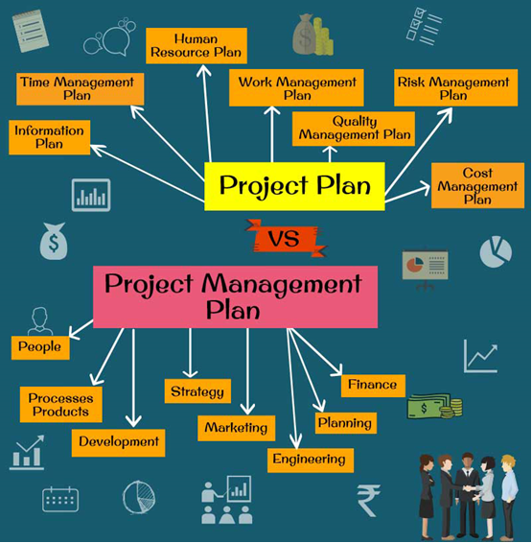
Project Plan vs Project Management Plan Infographics

Slide 32
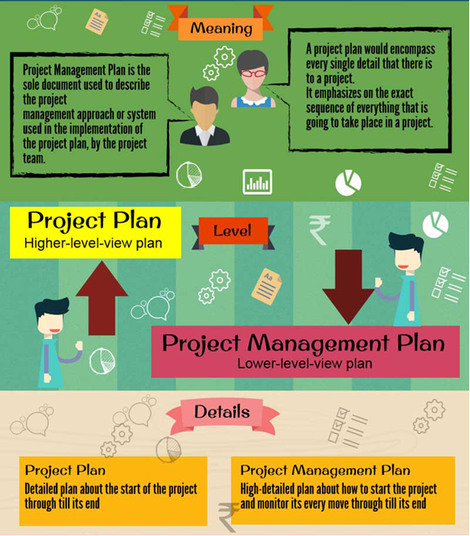
Project Plan vs Project Management Plan Infographics

Slide 33
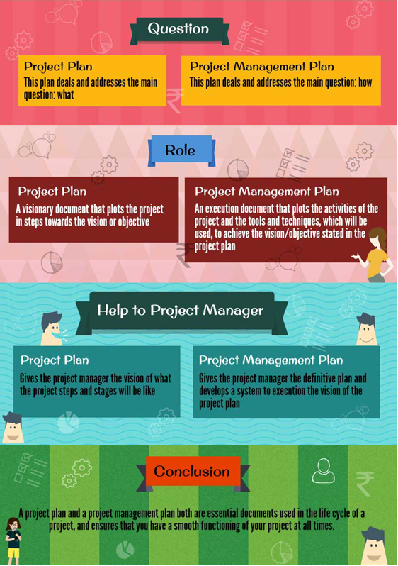
Project Plan vs Project Management Plan Infographics

Slide 34
I- PROJECT PLANNING
Project Master Plan
Elements of Project Master Plan
Overview
  - brief description of project
  - deliverables
  - milestones
  - expected profitability and competitive impact
  - intended for senior management
Objectives
  - detailed description of project’s deliverables
  - project mission statement

Slide 35
I- PROJECT PLANNING
Project Master Plan
Elements of Project Master Plan
General approach
  - technical and managerial approaches
  - relationship to other projects
  - deviations from standard practices
Contractual aspects
  - agreements with clients and third parties
  - reporting requirements
  - technical specifications
  - project review dates

Slide 36
I- PROJECT PLANNING
Project Master Plan
Elements of Project Master Plan
Schedules
  - outline of all schedules and milestones
Resource requirements
  - estimated project expenses
  - overhead and fixed charges
Personnel
  - special skill requirements
  - necessary training
  - legal requirements

Slide 37
I- PROJECT PLANNING
Project Master Plan
Elements of Project Master Plan
Evaluation methods
  - evaluation procedures and standards
  - procedures for monitoring, collecting, and storing data on project performance
Potential problems
  - list of likely potential problems

Slide 38
I- PROJECT PLANNING
SUMMARY
A project plan and a project management plan both are essential documents used in the life cycle of a project, and ensures that you have a smooth functioning of your project at all times. Being able to be in full control of your project would mean that your planning was done with sincere dedication and thorough organization. The planning when satisfactorily done constitutes of 80% of the work, which is a sure win for you as a project manager.

Slide 39
I- PROJECT PLANNING
SUMMARY
Project management planning – Definition
A project management plan is a document used to describe every phase of a project. The components may include initiating, planning, executing, monitoring and controlling, and closing.

Slide 40
I- PROJECT PLANNING
SUMMARY
Why are Project Management Plans needed?
Imagine it's Christmas, you are seven years old, and you just received a new bicycle for Christmas - but as you rip off the paper, to your surprise, it's in a box. Bicycles don't come in a box! You think this has to be a joke until you realize assembly is required. The construction of the bicycle requires the assembler to follow the step-by-step instructions to be able to use the bicycle. Project management plans are the same because they require steps to be followed for the successful completion of a project. While the example of the bicycle assembly is a simple example, the same process happens with project plans.

Slide 41
I- PROJECT PLANNING
SUMMARY
Purpose of the Project Management Plan
The project management plan adds structure to the process by assigning an order to all the important parts involved in the plan. The purpose of a project management plan (PMP) is to determine the project outcome, how a successful outcome will be achieved, who will be involved in the project, and how the project will be measured and communicated. Like any blueprint, you have to know what you are trying to do; so having a goal is important. Secondly, you have to know how you are going to achieve those goals by knowing which people in the process play which roles.

Slide 42
I- PROJECT PLANNING
Project Management Plan Steps
There are multiple steps in a project management plan and can vary depending on the person and project, however, there are some standard steps to take when creating a PMP.

Slide 43
I- PROJECT PLANNING
Project Management Plan Steps
Initiating: In the first step of the PMP process, it is essential to the success of the project for the project manager to identify the project, secure finances to fund the project, and set up communication for the vital dialogue that will happen between shareholders.
Planning: The second step in the PMP process is the planning stage. The planning stage is critical because there are many high priority issues identified such as time, cost, quality, change, and risk issues.

Slide 44
I- PROJECT PLANNING
Project Management Plan Steps
Executing: The executing phase is the most active stage of the process because things such as meetings and development updates of the process take place. These items are developed and delivered in this phase.
Monitoring and Controlling: In the monitoring and controlling phase, the progress of the project is monitored to ensure projects meet deadlines, and the project overcomes roadblocks. That is part of the monitoring. If something is wrong and needs to be adjusted or changed, it is done in the controlling phase.

Slide 45
I- PROJECT PLANNING
Project Management Plan Steps
Closing: This is the conclusion of the project. Any last items not finished are assigned, any nonessential employees are let go or reassigned, and efforts on the project are recognized.

Slide 46
THE PLANNING PROCESS

Slide 47
I- PROJECT PLANNING
Planning is answering questions
What must be done?
How should it be done?
Who will do it?
By when must it be done?
How much will it cost?
How good does it have to be?

Slide 48
I- PROJECT PLANNING
Plan ingredients
Problem statement
Project mission statement
Project objectives
Project work requirements (incl. a list of all deliverables, such as reports, hardware, software…)
Exit criteria
End-item specifications to be met (engineering, architectural, codes, government regulations…)
Work Breakdown Structure (WBS)
Schedules (milestones, working schedules…)
Required resources (people, equipment, materials, facilities…)
Control system
Major contributors
Risk areas with contingencies when possible

Slide 49
I- PROJECT PLANNING
Suggestions for effective planning
The people who must do the work should participate in developing the plan.
The first rule of planning is to be prepared to replan!
Identify project risks and develop contingencies to deal with them if the occur.
Be sure the project really satisfies the customer’s needs, rather than being what the team thinks the customer should get.

Slide 50
II -PROJECT SCHEDULING
What Is Project Scheduling ?
Project scheduling is a mechanism to communicate what tasks need to get done and which organizational resources will be allocated to complete those tasks in what timeframe. A project schedule is a document collecting all the work needed to deliver the project on time.
But when it comes to creating a project schedule, well, that’s something few have deep experience with.
What and who is being scheduled, and for what purposes, and where is this scheduling taking place, anyway?

Slide 51
II -PROJECT SCHEDULING
What Is Project Scheduling ?
For example, most tools have task lists, which enable the manager to schedule multiple tasks, their due dates, sometimes the planned effort against that task, and then assign that task to a person. The software might also have resource scheduling, basically the ability to schedule the team’s availability, but also the availability of non-human resources like machines or buildings or meeting rooms.

Slide 52
II -PROJECT SCHEDULING
What Is Project Scheduling ?
Because projects have so many moving parts, and are frequently changing, project scheduling software automatically updates tasks that are dependent on one another, when one scheduled task is not completed on time. It also generates automated email alerts, so team members know when their scheduled tasks are due or overdue, and to let the manager know when someone’s availability has changed.
Project scheduling is simple when managed online, thankfully, especially since the software does all the hard part for you!

Slide 53
II -PROJECT SCHEDULING
How to Schedule a Project
Before going deeper into project scheduling, let’s review the fundamentals to project scheduling. Project scheduling occurs during the planning phase of the project. You have to ask yourself three questions to start:
1. What needs to be done?
2. When will it be done?
3. Who will do it?

Slide 54
II -PROJECT SCHEDULING
How to Schedule a Project
Once you’ve got answers to these questions, then you can begin to plan dates, link activities, set the duration, milestones and resources. The following are the steps needed to schedule a project:

Slide 55
II -PROJECT SCHEDULING
How to Schedule a Project
Define Activities
What are the activities that you have to do in the project? By using a Work Breakdown Structure (WBS) and a deliverables diagram, you can begin to take these activities and organize them by mapping out the tasks necessary to complete them in an order than makes sense.

Slide 56
II -PROJECT SCHEDULING
How to Schedule a Project
Do Estimates
Now that you have the activities defined and broken down into tasks, you next have to determine the time and effort it will take to complete them. This is an essential piece of the equation in order to calculate the correct schedule.

Slide 57
II -PROJECT SCHEDULING
How to Schedule a Project
Determine Dependencies
Tasks are not an island, and often one cannot be started until the other is completed. That’s called a task dependency, and your schedule is going to have to reflect these linked tasks. One way to do this is by putting a bit of slack in your schedule to accommodate these related tasks.

Slide 58
II -PROJECT SCHEDULING
How to Schedule a Project
Assign Resources
The last step to finalizing your planned schedule is to decide on what resources you are going to need to get those tasks done on time. You’re going to have to assemble a team, and their time will need to be scheduled just like the tasks.

Slide 59
II -PROJECT SCHEDULING
How to Schedule a Project
How to Maintain Your Schedule Once the Project Is Initiated
Once you’ve got all the pieces of your schedule together, the last thing you want to do is manually punch it into a static document like an Excel spreadsheet. Project management software can automate much of the process for you. But not all project management software is the same.
There are programs on the market that are great for simple scheduling duties, but when you’re leading a project, big or small, you need a tool that can adapt to the variety of scheduling issues you’re going to need to track. Like noted above, there are three tiers of scheduling: tasks, people and projects.

Slide 60
III- PROJECT MONITORING AND CONTROLLING
Every project has a life cycle. During this life cycle, there are several phases called ‘process groups‘. Each of these process groups has a different and crucial objective, which helps to produce desired outcomes in a project. Project monitoring and controlling process group activities help to keep the project on track. Project monitoring and controlling, unlike the other phases, is done from the beginning until the end of the project. These project monitoring and controlling process activities check whether the project is going as planned and whether there are any deviations from the baseline. So this process group covers all the other four process groups.

Slide 61
III- PROJECT MONITORING AND CONTROLLING
Why the project monitoring and controlling phase is important?
For a successful project, there are some best practices to implement a good project monitoring & controlling. Because monitoring and controlling activities check if there are deviations from the expected results of the project. So what kind of activities should be done during this important phase? In this article, we will list the project monitoring and controlling process group best practices one-by-one.

Slide 62
III- PROJECT MONITORING AND CONTROLLING
The 16 Best Practices for Project monitoring and controlling process
Project monitoring and controlling step #1: Take action to control the project
Necessary steps, control points, and actions are taken to monitor and control the project. These actions provide if the project is deviating from the planned baseline.

Slide 63
III- PROJECT MONITORING AND CONTROLLING
The 16 Best Practices for Project monitoring and controlling process
Project monitoring and controlling step #2: Measure performance
You should measure the performance in order to check whether the project is going well. For instance, cost performance of the project will give an indication whether the planned budget will be sufficient to complete the project. Schedule performance of the project will give an indication whether the planned schedule and dates can be reached.

Slide 64
III- PROJECT MONITORING AND CONTROLLING
The 16 Best Practices for Project monitoring and controlling process
Project monitoring and controlling step #3: Determine variances and if they warrant a change request
If there is a lot of variance from the baseline, for instance, if it is expected that the project duration will exceed the planned duration by 20%, then regarding actions must be taken to meet the project targets.

Slide 65
III- PROJECT MONITORING AND CONTROLLING
The 16 Best Practices for Project monitoring and controlling process
Project monitoring and controlling step #4: Influence the factors that cause changes
Changes are inevitable in a project. But, preventive actions can be taken to influence the factors that cause changes. For instance, a detailed scope and requirement clarification with the customer will reduce the changes that will be coming from the customer.

Slide 66
III- PROJECT MONITORING AND CONTROLLING
The 16 Best Practices for Project monitoring and controlling process
Project monitoring and controlling step #5: Request changes
If there is a deviation from the planned values, then a change can be requested to meet the planned values again.

Slide 67
III- PROJECT MONITORING AND CONTROLLING
The 16 Best Practices for Project monitoring and controlling process
Project monitoring and controlling step #6: Perform integrated change control
Changes in a project must be implemented in an integrated manner. Because a small change in one aspect of the project might impact the overall project. Performing an integrated change control evaluates the changes and its impacts on the project. Then, a proper change implementation is planned to minimize the risk of changes.

Slide 68
III- PROJECT MONITORING AND CONTROLLING
The 16 Best Practices for Project monitoring and controlling process
Project monitoring and controlling step #7: Approve or reject changes
Project monitoring and controlling process may approve or reject changes. Changes are evaluated by the change control board and if this board rejects the change, it won’t be implemented. If a change is approved, project plan revisions must be done and change should be implemented properly.

Slide 69
III- PROJECT MONITORING AND CONTROLLING
The 16 Best Practices for Project monitoring and controlling process
Project monitoring and controlling step #8: Inform stakeholders of approved changes
If the decision of the change control board is approving a change. This must be communicated to the stakeholders. Because, the previous plan, scope, and targets have a change. So the stakeholders must be notified about this change.

Slide 70
III- PROJECT MONITORING AND CONTROLLING
The 16 Best Practices for Project monitoring and controlling process
Project monitoring and controlling step #9: Manage configuration
The configuration of a project describes the meaningful and properly working combination of different modules or parts. In order to ensure healthy project progression, the configuration is managed.

Slide 71
III- PROJECT MONITORING AND CONTROLLING
The 16 Best Practices for Project monitoring and controlling process
Project monitoring and controlling step #10: Create forecasts
Project monitoring and controlling process group activities create forecasts. What will be the budget of the project on completion? What will be the end date of the project if the project performs as it performed till now? These types of forecasts help to see how far the project is from its targets.

Slide 72
III- PROJECT MONITORING AND CONTROLLING
The 16 Best Practices for Project monitoring and controlling process
Project monitoring and controlling step #11: Gain acceptance from customer
Once the project deliverables are completed, they are presented to the customer. If the deliverables meet the requirements agreed with the customer, in the beginning, the customer accepts the project and closing phase is triggered.

Slide 73
III- PROJECT MONITORING AND CONTROLLING
The 16 Best Practices for Project monitoring and controlling process
Project monitoring and controlling step #12: Perform quality control
Quality control activities check the quality attributes of the delivered outputs. For instance, the product of a project might meet the budget and schedule targets. But the quality requirements might not meet the customers’ expectations. In this case, the project will be considered as failed as well. Therefore, performing a quality control is important.

Slide 74
III- PROJECT MONITORING AND CONTROLLING
The 16 Best Practices for Project monitoring and controlling process
Project monitoring and controlling step #13: Report on project performance
Since forecasting and project performance is measured during monitoring and controlling, project performance reports are sent to relevant stakeholders during this phase as well.

Slide 75
III- PROJECT MONITORING AND CONTROLLING
The 16 Best Practices for Project monitoring and controlling process
Project monitoring and controlling step #14: Perform risk audits
Risks may affect a project drastically. Therefore, each anticipated risk must be documented, and risk response strategies for each risk must be planned in case a risk occurs.

Slide 76
III- PROJECT MONITORING AND CONTROLLING
The 16 Best Practices for Project monitoring and controlling process
Project monitoring and controlling step #15: Manage reserves
Reserves are planned to accommodate costs of risks and unexpected situations in projects. For instance, if the project budget is 100,000 USD, a 10% reserve can be planned to accommodate impacts of risks. Or, if the project duration is 12 months, an additional 2 months can be planned as a buffer to overcome any kind of risks that might occur during the project. These reserves are managed in monitoring and controlling phase.

Slide 77
III- PROJECT MONITORING AND CONTROLLING
The 16 Best Practices for Project monitoring and controlling process
Project monitoring and controlling step #16: Administer procurements
Tools, equipment or resources can be outsourced from a supplier during a project. Administration of these purchases, outsourcing, and leasing activities are done during monitoring and control phase of a project.

Slide 78
III- PROJECT MONITORING AND CONTROLLING
The 16 Best Practices for Project monitoring and controlling process
If a successful monitoring and controlling process can be implemented, the whole project has a better chance to be a success. So the outcomes of closing process group activities will be as planned in the planning phase.

Slide 79
IV-PROJECT EVALUATION AND TERMINATION
We now come to the final stage in any project—evaluating the result and closing the project. As we will see, there are many ways to do both, some relatively formal, some quick and dirty, and some rather casual. We discuss evaluation first, in the generic sense, and then discuss a very specific and often formal type of evaluation known as the project audit. Following this we discuss termination of the project.

Slide 80
IV-PROJECT EVALUATION AND TERMINATION
1. EVALUATION
The term “evaluate” means to set the value of or appraise. A project evaluation appraises the progress and performance relative to the project’s initial or revised plan. The evaluation also appraises the project against the goals and objectives set for it during the selection process.

Slide 81
IV-PROJECT EVALUATION AND TERMINATION
1. EVALUATION
1.1 Evaluation Criteria
There are many different measures that may be applied in a project evaluation. Project management team may have particular areas that they want to evaluate for future planning and decisions. One study identified four important dimensions of project success.

Slide 82
IV-PROJECT EVALUATION AND TERMINATION
1.2 Evaluation Methods
1.2.1 PROJECT AUDITING
Objective:
The project audit is a thorough examination of the management of a project, its methodology and procedures, its records, properties, budgets, expenditures, progress, and so on.
The project audit is not a financial audit but is far broader in scope and may deal with the whole or any part of the project.

Slide 83
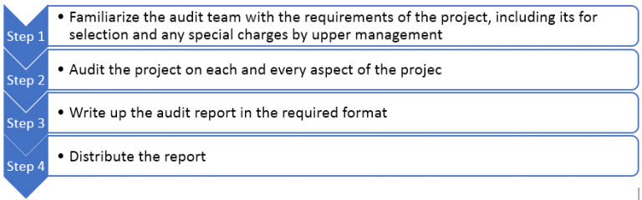
IV-PROJECT EVALUATION AND TERMINATION
Typical steps in a project audit are:

Slide 84
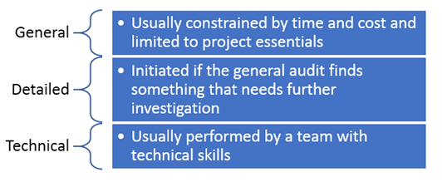
IV-PROJECT EVALUATION AND TERMINATION
1.2.2 Audit Levels:
An audit can be conducted at three levels:

Slide 85
IV-PROJECT EVALUATION AND TERMINATION
1.3 Project Termination
Eventually the project is terminated, either quickly or slowly, but the manner in which it is closed out will have a major impact on the quality of life in the organization. Occasionally, the way project termination is managed can have an impact on the success of the project. As part of the project termination, contracts will be closed with all the service providers.

Slide 86
IV-PROJECT EVALUATION AND TERMINATION
2. Project Contract
A contract is an exchange of promises between two or more parties to do, or refrain from doing an act, which resulting contract is enforceable in a court of law. In the project or program context, contracts typically involve the exchange of money in return for goods or services.
If an organization decides to “buy” from one or more outside sources, it must select the type of contract it needs. In selecting what type of contract to use, the primary objective is to have risk distributed between the buyer and seller so that both parties have motivation and incentives for meeting the contract goal.

Slide 87
IV-PROJECT EVALUATION AND TERMINATION
2. Project Contract
Factors of Influence:
Type and complexity of requirement.
The extent of price competition.
Cost and price analysis.
Urgency of requirement or performance period.
A frequency of expected changes.
Industry standards of types of contracts used.
Whether or not there is a well-defined statement of work.
Overall degree of cost and schedule risk

Slide 88
IV-PROJECT EVALUATION AND TERMINATION
2. Project Contract
2.1 Type of Contracts:
2.1.1 Turnkey Contracts:
A Turnkey Contract is one under which the contractor is responsible for both the designand construction of a facility. The basic concept is that in a Turnkey Contract the contractor shall provide the works ready for use at the agreed price and by a fixed date

Slide 89
IV-PROJECT EVALUATION AND TERMINATION
2. Project Contract
2.1 Type of Contracts:
2.1.2 Non-turnkey Contracts:
This contract is handled by the in house team of the organization which is floating the contract. That means the overall supervision and responsibility lies with the in house department.
There are multiple type of contracts in this category.

Slide 90
IV-PROJECT EVALUATION AND TERMINATION
2. Project Contract
2.1 Type of Contracts:
2.1.2 Non-turnkey Contracts:
2.1.2.1 Cost reimbursable (or Cost Plus) Cost reimbursable (CR) contracts involve payment based on sellers’ actual costs as well as a fee or incentive for meeting or exceeding project objectives. Therefore, the buyer bears the highest cost risk.

Slide 91
IV-PROJECT EVALUATION AND TERMINATION
2. Project Contract
2.1 Type of Contracts:
2.1.2 Non-turnkey Contracts:
2.1.2.2 Fixed Price Contracts Fixed price (FP) contracts (also called lump-sum contracts) involve a predetermined fixed price for the product and are used when the product is well defined. Therefore, the seller bears a higher burden of the cost risk than the buyer.

Slide 92
IV-PROJECT EVALUATION AND TERMINATION
2. Project Contract
2.1 Type of Contracts:
2.1.2 Non-turnkey Contracts:
2.1.2.3 Time and Material Contracts
Time and material (T&M) contracts (sometimes called Unit Price Contracts) contain characteristics of both fixed price and cost reimbursable contracts and are generally used for small project cost amounts. These contracts may be priced on a per-hour or per-item basis (fixed price) but the total number of hours or items is not determined (open-ended cost type arrangements like CR contracts)

Slide 93
IV-PROJECT EVALUATION AND TERMINATION
Miscellaneous Topics
Enterprise Resource Planning
Definition
Enterprise Resource Planning (ERP) is business process management software that allows an organization to use a system of integrated applications to manage the business and automate many back office functions related to technology, services and human resources.

Slide 94
IV-PROJECT EVALUATION AND TERMINATION
Characteristics:
ERP software typically integrates — including product planning, development, manufacturing, sales and marketing — in a single database, application and user interface.
Small business ERP applications are lightweight business management software solutions, often customized for a specific business industry or vertical.
The basic goal is to provide one central repository for all information that is shared by all teams across the organization.

Slide 95
IV-PROJECT EVALUATION AND TERMINATION
Finance – gathers financial data and generates reports such as ledgers, trial balance data, overall balance sheets and quarterly financial statements.
Human resource management – gathers data and generates reports about such things as employee recruitment, performance reviews, training and professional development, performance reviews, mediation and exit interviews.
Inventory management – gathers data and generates reports about non-capitalized assets and stock items.
Supply chain management – gathers data and generates reports about materials, information, and finances as they move in a process from supplier to manufacturer to wholesaler to retailer to consumer.

Slide 96
IV-PROJECT EVALUATION AND TERMINATION
Business Value of ERP
Improved business insight | From real-time information generated by reports
Lower operational costs | Through defined and more streamlined business processes
Enhanced collaboration | From users sharing data in contracts, requisitions, and purchase orders
Improved efficiency | Through a common user experience across many business functions and managed business processes
Consistent infrastructure | From the back office to the front office, all business activities have the same look and feel
Lower management and operational costs | Through uniform and integrated systems
Reduced risk | Through improved data integrity and financial controls

Slide 97
IV-PROJECT EVALUATION AND TERMINATION
ABC Analysis
Objective:
The ABC analysis helps to focus control efforts in areas where it is most needed. The basis of classification is usage value of the items and not their physical quantities. This classification will help the organization to identify the items which are of high importance.
ABC analysis is an inventory categorization method which consists in dividing items into three categories (A, B, C): A being the most valuable items, C being the least valuable ones. This method aims to draw managers’ attention on the critical few (A-items) not on the trivial many (C-items). The classification can be extended to D,E,F etc., if needed.

Slide 98
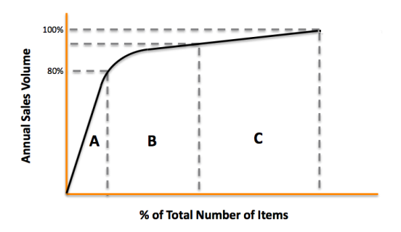
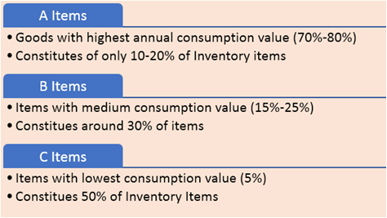
IV-PROJECT EVALUATION AND TERMINATION
ABC Analysis

Slide 99
Questions for Preparation of the final exam
1-what is the project plan ?
2-Why does a project need plans ?
3-Which are four basic questions,posed for a project ?
4-What is the difference between Project and projest management plan (slide 29) . The main question for them (slide 33) ?
Definition of Project management planning ?

